Slide 1
Identifications of Different Waveforms
Andrew Wang

Slide 2
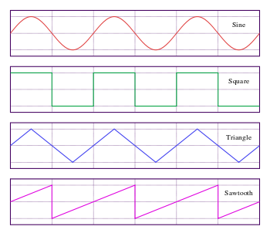

Slide 3
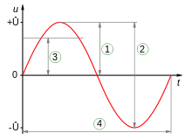
1 = Peak amplitude (U)
2 = Peak-to-peak amplitude (2U)
3 = RMS amplitude (U/2^(1/2))
4 = Wave period (not an amplitude)

Slide 4
Oscilloscope Measurement
Rise and Fall Times
Discrete Fourier Transforms (DFT)
Fast Fourier Transforms (FFT)
Phase Shift

Slide 5
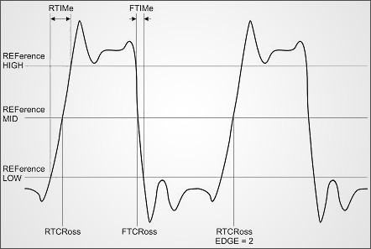
Rise and Fall Times

Slide 6
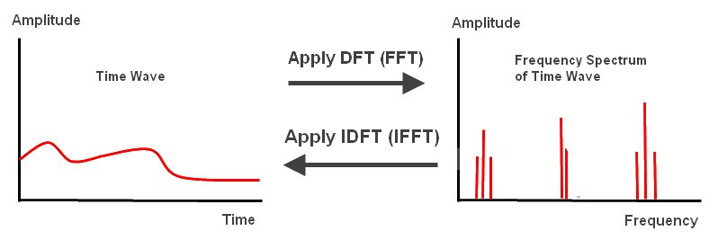
Discrete Fourier Transforms (DFT) and Fast Fourier Transforms (FFT)

Slide 7
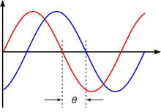
Phase Shift
Unit – angle θ
Phase shift is any change that occurs in the phase of one quantity, or in the phase difference between two or more quantities.
Phase difference is the difference, expressed in electrical degrees or time, between two waves having the same frequency and referenced to the same point in time.

Slide 8
Article: Analysis of Non-Sinusoidal Waveforms
Symmetry in Waveforms
- Even Symmetry
- Odd Symmetry
- Half-wave Symmetry

Slide 9
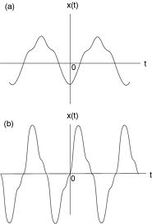
(a) Even Symmetry
f(t) = f(-t)
f(t) = (−) f(-t)
(b) Odd Symmetry

Slide 10
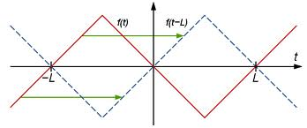
Half-wave Symmetry
f (t) = (−) f (t − T/2) = (−) f (t + T/2)

Slide 11
FAN-50kHz_Sampling

Slide 12
HP-50kHz_Sampling

Slide 13
STB-50kHz_Sampling

Slide 14
TV-50kHz_Sampling

Slide 15
Thanks

